Slide 1


Code Refactoring and Bug Fixing

Slide 2
About me
I am A M Suneel Kumar, a tech enthusiast with a Master's in ES-VLSI. Currently interning at Innomatics Research Labs, my expertise lies in Python, MySQL, and Power BI. My project portfolio demonstrates a keen focus on leveraging data for strategic insights, ranging from Pizza Delivery Management to Marketing Campaign Analysis.
With a dynamic perspective on the intersection of technology and data analytics, I am dedicated to contributing innovative solutions. Passionate about staying ahead in the ever-evolving tech landscape, I bring a commitment to excellence and a drive for organizational success.
LinkedIn & GitHub Profiles:
GitHub: [https://github.com/MohanSuneel]
LinkedIn: [https://www.linkedin.com/in/mohansuneel/]

Slide 3
Agenda
1. Overview: Introduce the Note Taking Application developed using Python, Flask, and HTML by a team of data scientists.
2. Challenges: Highlight the encountered issues in the existing codebase, emphasizing the need for refactoring and bug fixing.
3. Refactoring: Discuss the steps taken to improve code structure and address identified deficiencies, ensuring a more robust and maintainable application.
4. Bug Fixing: Present the debugging process, including the identification and resolution of specific bugs that hindered the application's functionality.
5. Outcome: Conclude with the successful transformation of the Note Taking App, now functioning seamlessly after code refactoring and bug fixing efforts.

Slide 4
Overview
This project centers around a Note Taking Application developed by a data science team using Python, Flask, and HTML. The application faced challenges due to inexperienced backend development, resulting in functionality issues. The agenda involves a thorough examination of the existing codebase, implementing strategic code refactoring, and resolving identified bugs to ensure the seamless operation of the Note Taking App. The goal is not to recreate the application but to enhance its functionality through expert backend development practices.Challenges
Challenges
The project encountered several challenges stemming from the team's limited experience in backend development. Key issues included a lack of proper handling for form submissions, insufficient code organization, and shared state problems leading to note-related errors. Additionally, a failure to account for both GET and POST requests further impeded the application's functionality. The task involves addressing these challenges through systematic code refactoring and bug fixing to enhance the overall performance and user experience.

Slide 5
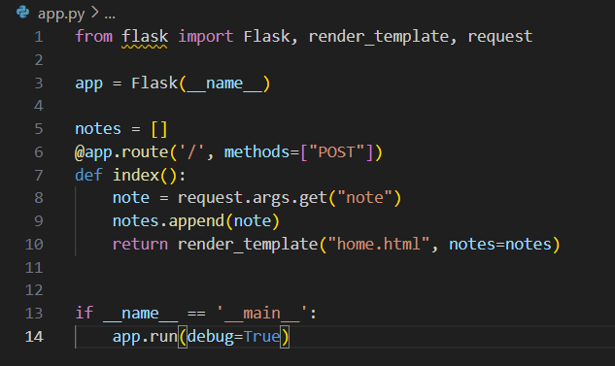
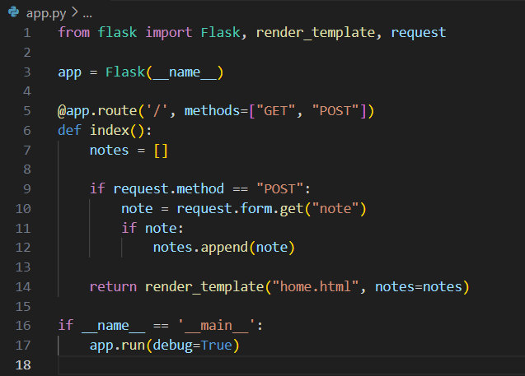
Refactoring
The refactoring phase focuses on enhancing the structure and maintainability of the existing codebase. This involves restructuring the Flask route to handle both GET and POST requests, initializing the 'notes' list within the function for improved encapsulation, and ensuring proper HTML form attributes for seamless data submission. The goal is to create a more organized and efficient code structure that aligns with best practices, making future development and maintenance smoother.
Code given for app.py
modifed code for app.py

Slide 6
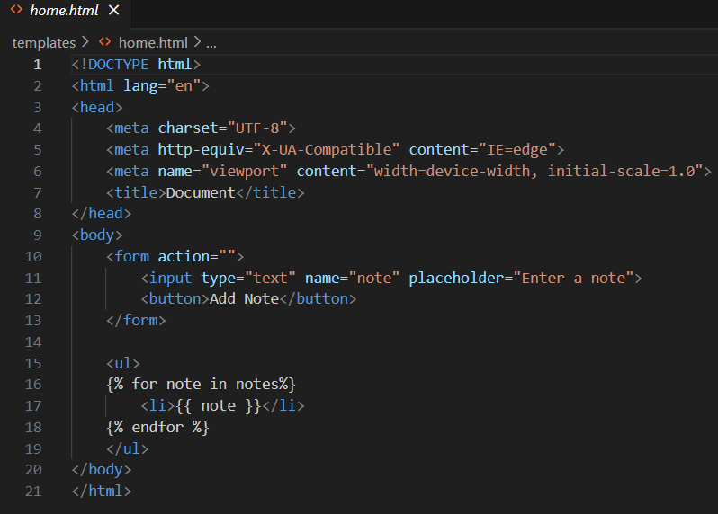
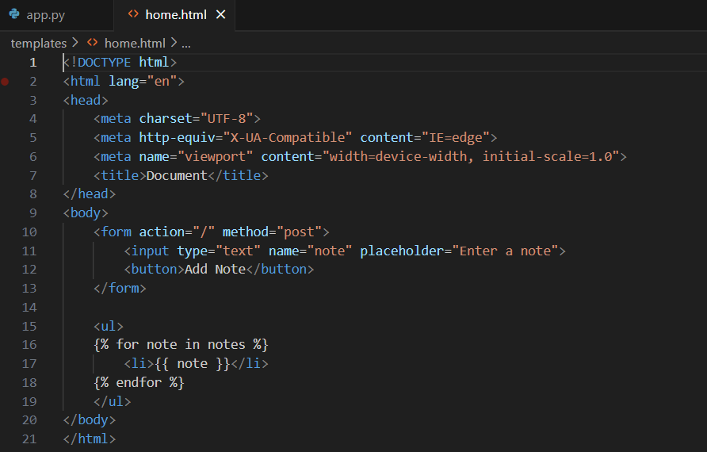
Bug Fixing
Bug fixing involves identifying and resolving critical issues within the Note Taking Application. This includes addressing a missing form method and action in the HTML, modifying the Flask route to handle both GET and POST requests, and resolving a shared state problem with the 'notes' list. By systematically addressing these bugs, the project aims to eliminate obstacles to the application's proper functionality, ensuring a seamless user experience.
Code given for home.html
modified code for home.html

Slide 7
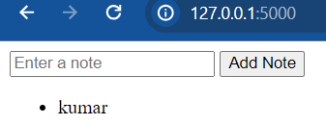
Outcome
Issue: Form in home.html missing the method attribute, and it defaults to GET.
Resolution: Set the method attribute of the form to POST to align with the Flask route.
Issue: Form in home.html missing the action attribute, and it defaults to an empty string.
Resolution: Set the action attribute of the form to "/" to submit the form to the root URL.
Issue: Flask route in app.py set to handle only POST requests.
Resolution: Modify the Flask route to handle both GET and POST requests.
Issue: The notes list in app.py is initialized outside the route function, leading to the shared state between requests.
Resolution: Initialize the notes list inside the route function to ensure a clean slate for each request.

Slide 8

THANK YOU

